Slide 1

Space Analytics
By
Siva Naga Santosh Adabala
110596806

Slide 2
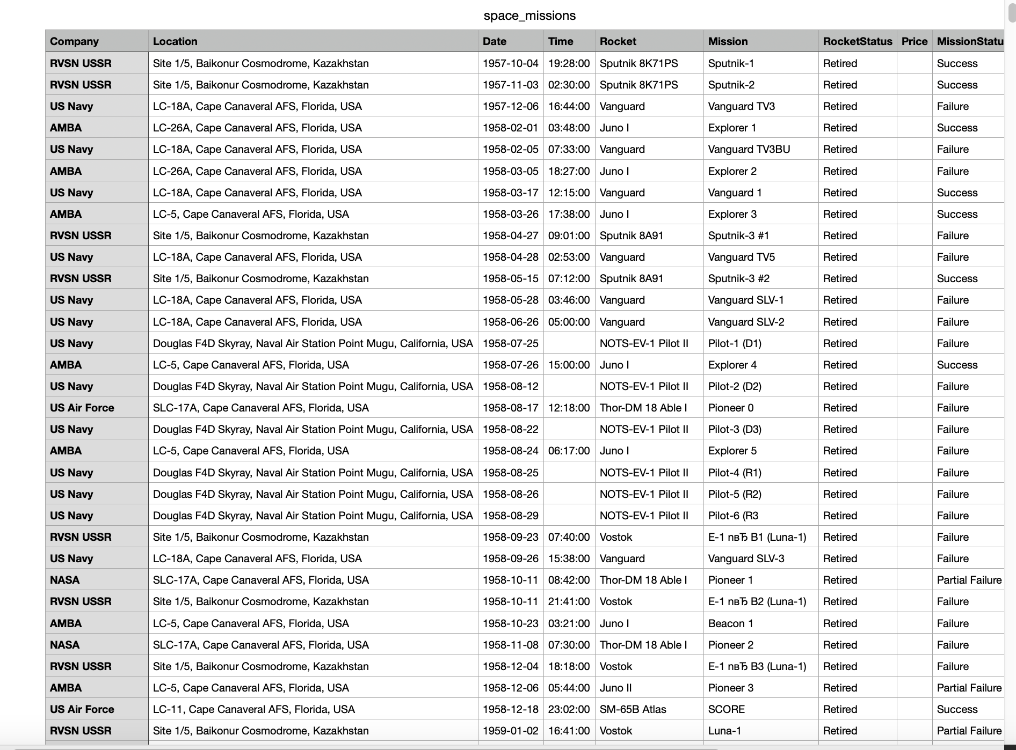
About Dataset
1
Comprehensive Historical Insights
Captures over 4,630 space missions from 1957 to 2022, showcasing the evolution of space exploration and technological advancements.
2
Trends and Patterns Analysis
Offers a deep dive into space exploration trends, including launch frequencies, mission success rates, highlighting industry dynamics.
3
Mission Diversity and Global Cooperation
Illustrates the broad spectrum of mission objectives and the collaborative efforts across countries, emphasizing the global nature of space exploration.

Slide 3
Strategic Approach
Step 1
Step 2
Step 3
Step 4
Extarcting Data
Cleaning Data
Analysing Data
Creating a Data Model
Step 5
Step 6
Step 7
Calculated Fields with DAX
Visualizing Data with Reports
Publishing the Data
Notes:
As we progress through our strategic roadmap, we are now at a critical stage that is Step 4, which focuses on Feature Analysis and Model Generation. At this stage, our goal is to translate the insights drawn from our data exploration into a robust recommendation model. Feature Analysis is crucial as it allows us to determine which data attributes are most predictive of user preferences and behavior. Our team employs various statistical methods and machine learning techniques to analyze and select features. With our key features identified, we move onto the model generation phase. where we develop a recommendation model that is tailored to our user's needs. The methods we apply here range from collaborative filtering to content-based filtering, and even exploring deep learning techniques. Once we have developed our initial model, we will proceed to Step 5, which is Model Refinement.

Slide 4
3 Key Research Questions
How have rocket launches trended across time? Has mission success rate increased?
Which countries have had the most successful space missions?
Which rocket has been used for the most space missions? Is it still active?

Slide 5
Link to PowerBI Desktop and Data
https://app.powerbi.com/groups/me/reports/a12c59cc-b725-4b84-b227-6a0d933dc291/ReportSection?experience=power-bi
https://drive.google.com/file/d/1YHh_nfKMx7UGOo1jUX-dpmB9mrUoOpQ_/view?usp=share_link

Slide 6
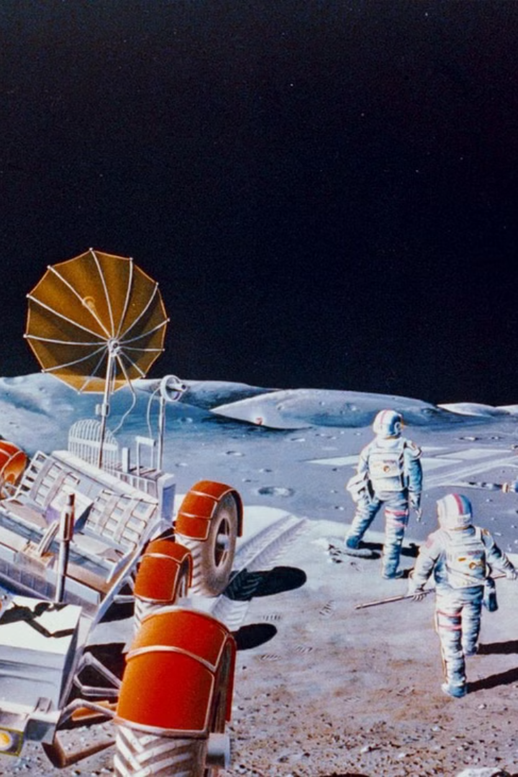
Conclusion
Space data and exploration continue to push the boundaries of human knowledge and capabilities, promising exciting discoveries and advancements in the years to come.

